Slide 1



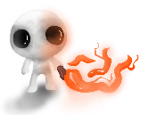
BY,
1. ANANYA JAYA KUMAR - 2018115140
2. HARINI V.K - 2018115036
3. PRASANNA PRIYAN .K - 2018115072

Slide 2
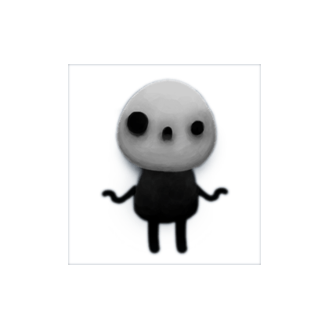
Introduction
Right from our childhood, we’ve all grown up playing different kind of games (be it a simple candy crush or subway surfers to NFS and GTA). Gaming is something that we are passionate about. As a result, we chose game programming as our professional elective after it was mentioned in one of the elective subjects. We reasoned that if we chose a project related to gaming, we would be able to learn more in hat area.
Game development is a growing field, and it gives us the freedom to be creative and combine all our favourite fields of interest (games, technical arts, computer science and technology). Sketching new characters and prototyping new features are all the more interesting. We learn through a method of trial and error, and there is still a lot more to explore. Hence, we chose a project related to game programming.

Slide 3

RESOURCES
No. This Project is not totally available elsewhere. We referred some Youtube tutorials and Forums to learn Unity. The resources are as follows.
Website References:
https://docs.unity3d.com/
https://learn.unity.com/
https://gamedev.stackexchange.com
Youtube Reference:
1. https://www.youtube.com/user/Brackeys

Slide 4

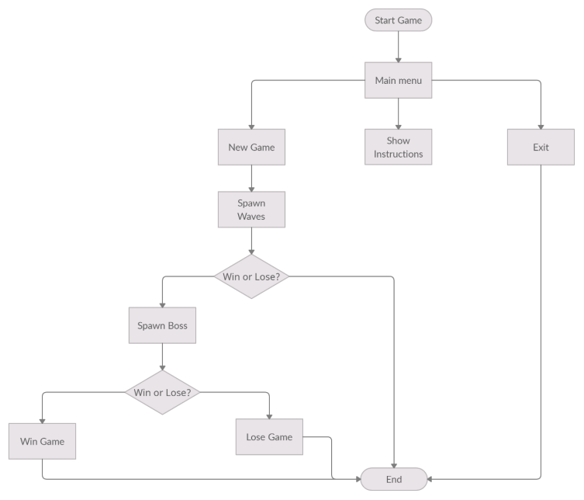
System flow diagram

Slide 5
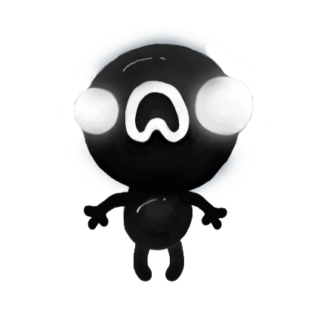
Algorithms
Finite State Machine Algorithm :
A finite-state machine, or FSM for short, is a model of computation based on a hypothetical machine made of one or more states. Only a single state can be active at the same time, so the machine must transition from one state to another in order to perform different actions.
FSMs are commonly used to organize and represent an execution flow, which is useful to implement AI in games. The "brain" of an enemy, for instance, can be implemented using a FSM: every state represents an action, such as ‘patrol’ , ‘chase’ , ‘attack’ etc.
We are planning to implement this algorithm to ‘The Boss’ character of this game as it needs to be a bit complex than all the other enemies. In this game, ‘The Boss’ character has two behavior based on its health points. If the Boss’s health is > half health points, it follows ‘Patrol Behavior’. In patrol behavior the boss moves towards a randomly selected predefined locations and follows a ‘Summon Behaviour’ in which it spawns random enemies.
If the Boss’s health < half health, it follows ‘Chase Behavior’. In chase behaviour, the Boss chases the player and melees him. The Boss’s attacks have a lot of damage points.

Slide 6

PORTION COMPLETED
Ananya Jaya Kumar - 2018115140
1. Sketched Player using Photoshop
2. Creating Idle, Run, Attack animation
3. Sketched Player Weapons
4. Sketched Melee Enemy, Ranged Enemy,
Summoner Enemy
5. Fly and Summon animations for special characters
6. Sketched Player and Enemy Bullets
7. Sketched Boss and created Idle, Patrol and Chase animations
8. Skethed Main menu, Victory and Lose scene
9. Programmed Scene Transitions script
10. Sketched new custom cursor
Harini V.K - 2018115036
1. Programmed base Enemy class,
2. Programmed Melee Enemy,
3. Programmed Ranged Enemy
4. Programmed Summoner Enemy
5. Programmed Enemy projectile scripts for special
characters
6. Programmed Weapon Pickup script
7. Created audio clips for game
8. Programmed Music and Random Sound scripts
9. Created Health Pickup
10. Programmed Health Pickup
Prasanna Priyan K - 2018115072
1. Programmed Player movement
2. Programmed Player Weapon
3. Programmed Player Bullet script
4. Programmed Background Camera follow
5. Programmed New Player Weapons
6. Programmed Wave Spawner
7. Created and Programmed Hurt panel,
8. Created and Programmed Screen Shake effect
9. Programmed Boss enemy using FSM algorithm
10. Created and Programmed Boss Health Bar slider

Slide 7

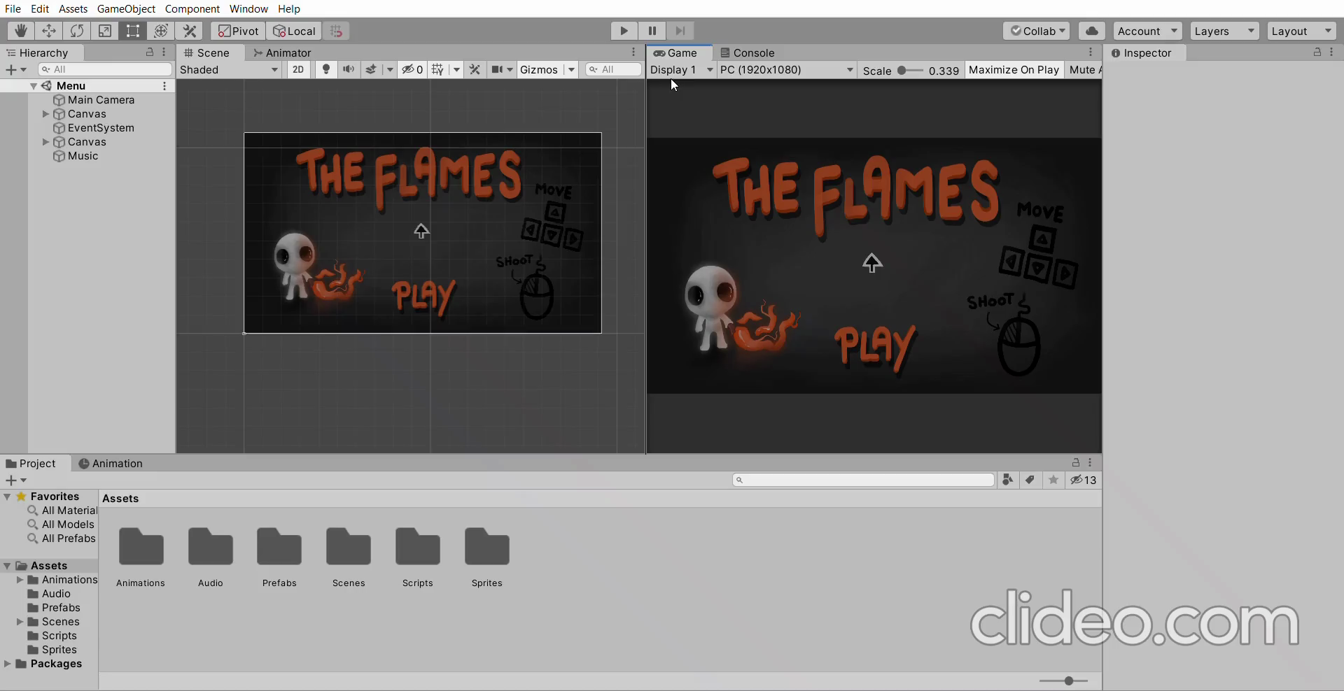
DEMO Video

Slide 8

ROLE OF MEMBERS
1. ANANYA JAYA KUMAR - GAME DESIGNER
2. HARINI V.K - GAME PROGRAMMER
3. PRASANNA PRIYAN .K - GAME PROGRAMMER

Slide 9
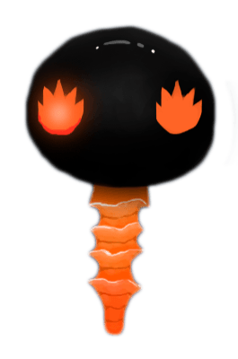
INNOVATION
Game programming on it’s own is a creative aspect. Starting from the development of characters, to the weapons/ accessories that they use and then defeating the enemies one by one, has to be planned, then meticulously executed.
This project is a 2D shooter game that is simple and fun to play. The gameplay is simple, the enemies are spawned in waves. If the player defeats all the enemies the next wave is spawned. When the player defeats all the enemies of the last wave the boss spawns. If the player defeats the boss then the player wins.
The game also features a variety of enemies, so the player has to change their strategy to defeat each of the enemies. There are various types of weapons in the game, and they have different stats so that the player can choose the weapon that best suits their gameplay style.

Slide 10

SATISFACTION
Game programming is a developing area, and we're all new to it. We enjoy how inventive we can be when creating new designs and protocols. It's a world of limitless imagination and possibilities. It is our first time trying to create a game, and we are learning and progressing, one step at a time.
So far, we are all satisfied with our work since we enjoy game development. We are learning new tactics and strategies and are also learning how to code to make a character behave a specific way. We have also learnt how to use Unity- which is a cross-platform game engine, useful for game development. Our sketches are primarily made on PhotoShop, and hence our sketching skills have also tremendously improved. In addition to this, we code all our characters in C# (specific for game development), and our coding skills have also gotten better with time.
To summarize, we have learned a lot and are pleased with our progress in this field despite the fact that we started with little experience.

Slide 11

Self Evaluation -
25/25
We had to go over the fundamentals extensively beforehand because we were all new to this. It took a long time to figure out what kind of game we all wanted and could agree on. Then we had to make sure that the game we chose was feasible and that we'd be able to complete it on time.
Starting with the characters (the main character, the bosses, and the weapons), we had to draw them out roughly with paper and pen before moving on to PhotoShop. Following that, we had to code everything in C#, a language we just knew the fundamentals of and needed to learn more in order to complete our project. Therefore, we had to correct all the errors as we made progress.
Learning to use Unity, was a bit of a challenge at first. But with time, we all got better at it. Once we got the hang of it, it was relatively easier to use and enabled us to demonstrate our project easily. Now, we have so much fun working with Unity- something we hadn’t even heard of before this semester.
Overall, all of us have put in a lot of hardwork and we learn something new everyday in order to accomplish our project on time. So, we would give us 25/25 for our work.

